Slide 1


Slide 2
Information about company
We are TS 16949 company into manufacturing of "Ready to Assemble" Grey Iron and Ductile Iron casting for OEM's mainly in Diesel Engine, Tractor and compressor industry. Also we are one of the largest manufacturer of the fully machined Oil Sump in India.

Slide 3
Establish
We an ISO/TS 16949 company started in 1974 . We are indulged in Manufacture & Machining of ‘Ready to Assemble & Sub-assembled” Grey Iron Castings components. We are single location integrated foundry and machine shop.

Slide 4
Owner
Directors of Shanti Foumach Private Limited
Santosh Kantilal Porwal,
Sarvesh Shantilal Porwal,
Kantilal Venmal Porwal
And
Shantilal Venmal Porwal.

Slide 5
Machines
We are single window from concept to testing with our integrated foundry and CNC machine shop in single location. Facilities include sophisticated fully automatic sand plant, Arpa molding line - 3 nose, Induction furnace and full fledged machine shop with CNC HMC's, VMC's and Turning Centre. Inspection facilities include spectrometer, UTM, image an a lyser, cleaning machine and CNC CMM.

Slide 6
QUALITY POLICY
We are committed to delight our customers by providing consistent quality products and on time services exceeding their expectations with continual improvement in QMS and processes with team effort.

Slide 7
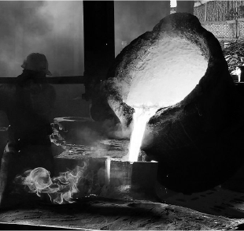
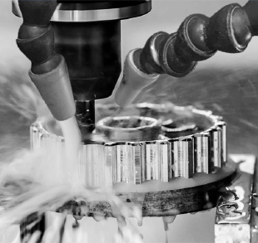
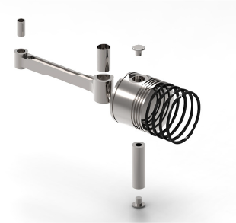
Grey & Ductile Iron Castings
Precision Machining Setup
Sub - Assembly

Slide 8








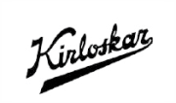
Asia, Europe, South America & USA

Slide 9
